Slide 1
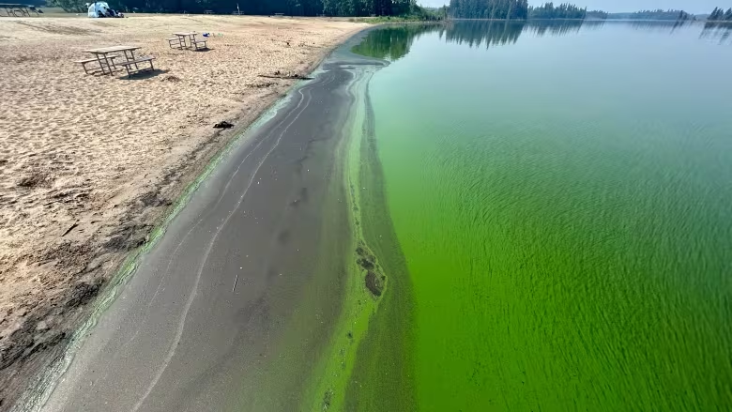

Predicting Blue-Green Algae Quantity in a Semi-Urban Reservoir
Nathan Jahns, M.Sc.
Data Science Intensive Capstone Project, Sept 23 Cohort

Slide 2
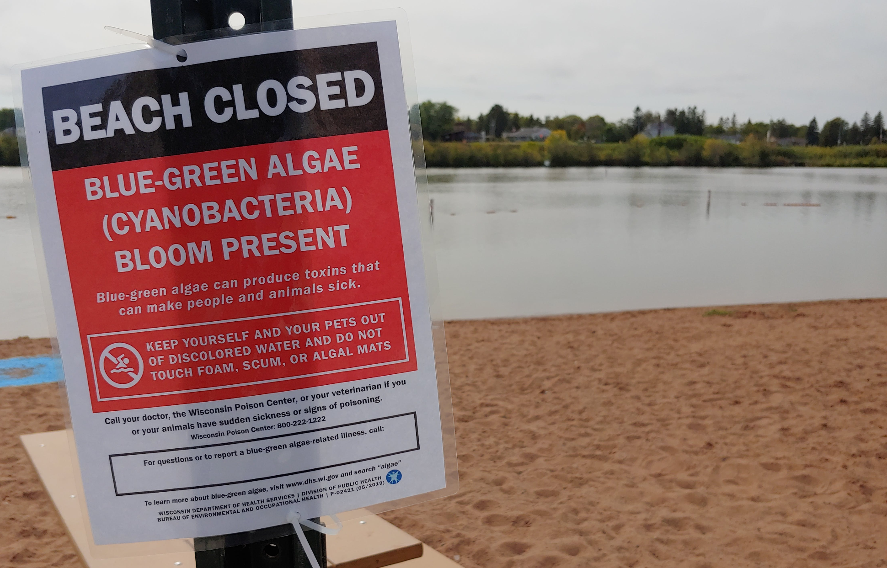
Background: Blue-Green Algae
Harmful algae blooms (HABs), mostly blue-green algae, in lakes across USA every summer and can grow over a few days
Can release toxins which kill fish, waterfowl, livestock, and pets and make humans very ill
Measure phycocyanin (pigment in blue-green algae) with in situ probe
Lake operators monitor readings and shut down recreation
Immediate, no warning to the public or staff, management actions are reactionary
Method to predict blue-green algae bloom before a shutdown would allow for planning and allocation of resources
Notes:
Harmful algae blooms (HABs) occur in lakes across the USA every summer. These HABs, which consist primarily of blue-green algae, are visibly unappealing and can release toxins which can kill fish, waterfowl, livestock, and pets and make humans very ill. Multiple methods exist for quantifying blue-green algae. The most immediate method is to measure phycocyanin, which is a pigment found in cyanobacteria. This sensor is often installed in situ and programmed to continuously collect data. Lake operators, such as a state park, will monitor these readings and shut down recreation on a lake if a blue-green bloom is detected. However, these closures are immediate, no warning is available to the public or staff, and all management actions are reactionary. Therefore, lake operators would be very interested in a method to predict blue-green algae in a lake before implementing a shutdown, allowing for planning and allocation of resources.

Slide 3
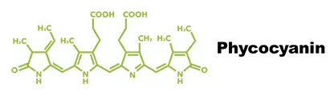
Objective
Develop machine learning models to predict phycocyanin using water quality measurements at a semi-urban reservoir I named Lake Fictitious
Establish models capable of forecasting phycocyanin multiple days in advance using the explanatory variables collected at the reservoir
With this model and data the magnitude of a HAB could be predicted before it occurs which would avoid immediate shutdowns
Notes:
Algae, including blue-green algae, can grow to a large volume over the course of days in the right condition. In this project, I developed machine learning models to predict phycocyanin using water quality measurements at an unnamed semi-urban reservoir I named Lake Fictitious. The primary objective was to establish models capable of forecasting phycocyanin multiple days in advance using explanatory variables also collected at the reservoir. With this model and data, the lake operator can predict the magnitude of a HAB before it occurs which would avoid immediate shutdowns.

Slide 4
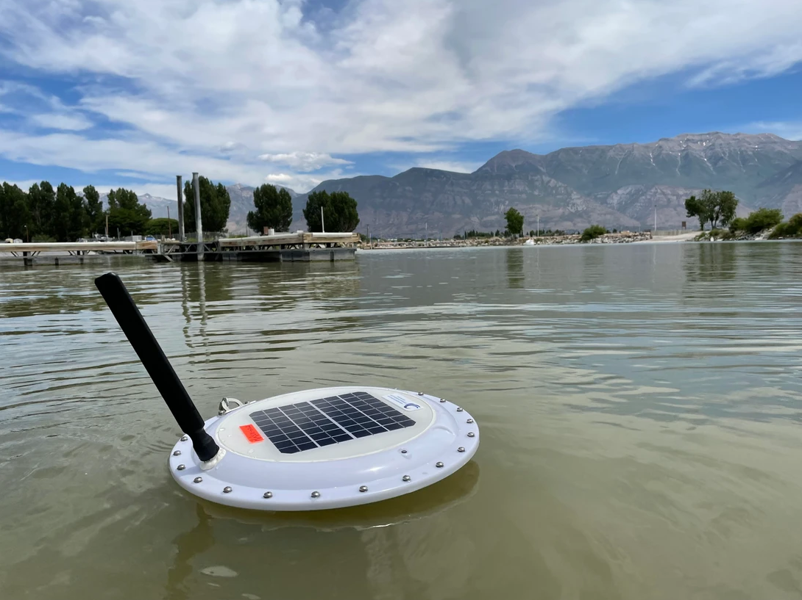
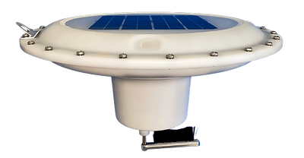
Data Acquisition
Data collected at Lake Fictitious every 30 minutes for three years
In situ AlgaeTracker manufactured by AquaRealTime
50,071 rows and 20 columns
Notes:
Water quality data, including phycocyanin, was collected at Lake Fictitious every 30 minutes for three years using an in situ AlgaeTracker manufactured by AquaRealTime. AquaRealTime provided me with a login to their data portal from which I downloaded Lake Fictitious data which consisted of 50,071 rows and 20 columns.

Slide 5
Data Cleaning
Removed unneeded columns
Phycocyanin, sunlight, water temperature, water turbidity, and chlorophyll-a
Removed duplicate date and time
Calculated mean because column values for pairs were often different
Both forward and backward directions from each NaN value
Inserted missing half hour rows
Largest gaps was 6.25 days, not too large to impute
Notes:
The first cleaning step was to remove all columns but those needed for developing a model. These consisted of phycocyanin, sunlight, water temperature, water turbidity, and chlorophyll-a.
Next, I had to address the many rows with the same date and time. Rather than simply deleting the second occurrence, I calculated the mean of the columns in the two rows because column values for multiple duplicate pairs were slightly different. During this process, I discovered that the data was collected every hour at the beginning of the study but switched to every half and hour at some point.
No data was missing from existing rows in the dataset. However, many rows were completely missing. I inserted these rows with the appropriate date and time but left teh values as NaNs for the time being. The largest of these data gaps was 6.25 days which is not too large to impute data which I performed in later steps.

Slide 6
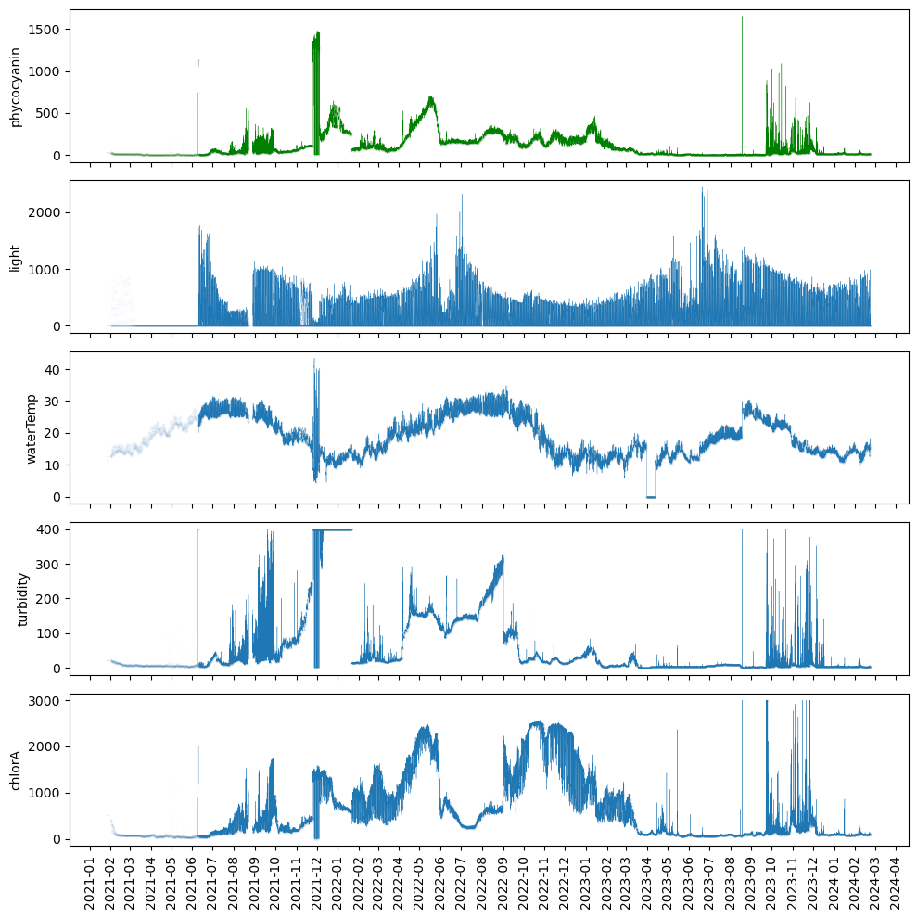
Data Cleaning
Unreliable data
Readings were collected every hour
Low sunlight readings
Unit flipped upside
Water temperature unlikely to be 0 ℃.
Maximums also unlikely.
Replaced with NaNs
Sunlight - replaced NaNs with mean 2022 and 2023 value
Spline linear interpolation to impute elsewhere
Notes:
I plotted the data with markers for each datapoint and lines connecting continuous data (Figure 1). I made the following observations in the plots:
Readings were collected every hour until roughly 6/10/21 when collection switched to every half hour.
The hourly readings at the beginning of the dataset for sunlight are all very low. These values would be expected at night but continuously for four months.
Around 12/1/21, the water all metric values are very extreme. AquaRealTime informed me that the unit was flipped upside down and the recorded values are incorrect.
Water temperature values in 4/23 are not reliable at zero degrees.
Other maximum readings for phycocyanin, water temperature, turbidity, and chlorophyll-a are also not reliable because these values are unlikely.
I addressed these unreliable data through many steps. First, I replaced the low hourly increment sunlight data, the values when the unit was flipped, and the low water temperature data with NaNs. I also replaced the unrealistic maximum values for each metric with NaNs. For sunlight, I replaced these NaNs and a gap in the data at the end of 8/21 with the mean values of the corresponding dates in 2022 and 2023. Linear interpolation would not be appropriate for this big data gap because light is high during the day and at zero every night and a straight line would not capture this day/night complexity over the time period. I then used spline linear interpolation to fill the data gaps I created in the other metrics and for all other NaNs in all metrics. This interpolation tries to ensure smoothness and continuity in the interpolated curve. In the end, my dataset contained no NaNs.

Slide 7
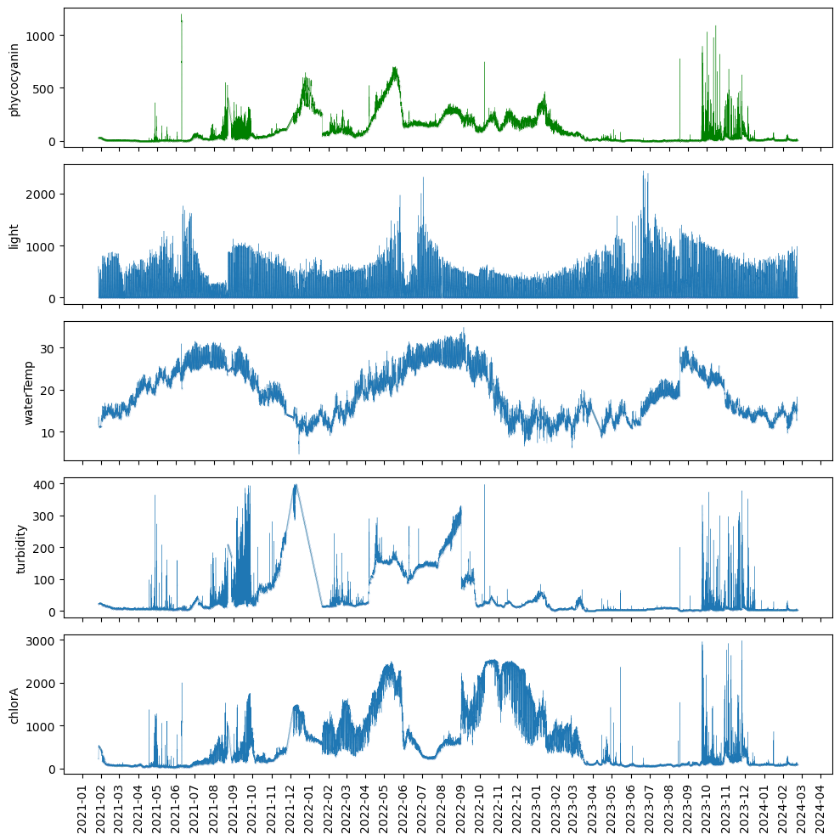
EDA: Trends & Patterns
Sunlight and water temperature were seasonal
June was cloudy each year and 2021 was also cloudy in July, Aug, and Dec
Phycocyanin, turbidity, and chlorophyll-a not seasonal and three years were different
Baseline was higher and readings often did not return to baseline for all metrics from 11/21-2/23
Notes:
I plotted the newly corrected metric data to assess the metrics for patterns and trends (Figure 2). As would be expected, sunlight and water temperature values follow a seasonal pattern of being higher in the summer and lower in the winter. June was cloudy every year and 2021 was also cloudy in July, Aug, and Dec.
Phycocyanin, turbidity, and chlorophyll-a did not appear to be seasonal and, in fact, the three years were very different from each other. Values often increased for short periods (days) but generally returned to baseline or close to baseline. Exceptions to returning to baseline occurred for turbidity from roughly 10/21-2/22 and 4/22-10/22, for phycocyanin and chlorophyll-a from roughly 12/21-2/22 and 4/22-6/22, and for just chlorophyll-a from roughly 9/22-1/23. Overall, baseline was higher from 11/21-2/23 for all three metrics. This variation from year to year is likely the result of 2021 being a cloudier year than 2022 and 2023 and from rainfall and nutrient inputs which were not a part of this study.

Slide 8
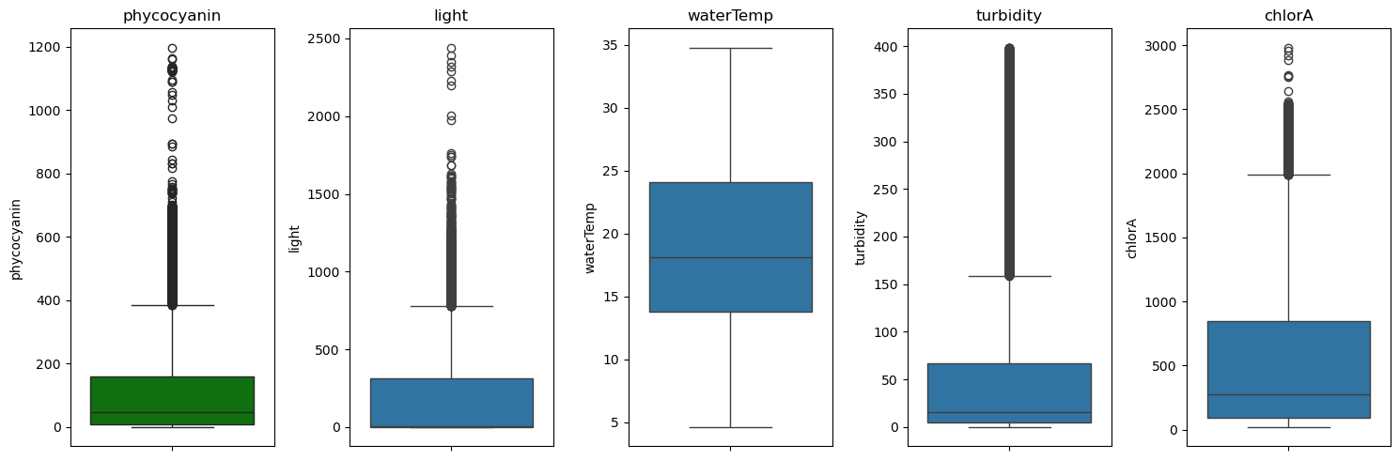
EDA: Distribution
Water temperature fell within the whiskers (1.5 times the IQR)
Other values greater than 3 std from the median were not removed because no reason to believe these are erroneous.
Notes:
I also created a boxplot for each metric (Figure 3). All values for water temperature fell within the whiskers (1.5 times the IQR). Many readings for phycocyanin, turbidity, and chlorophyll-a were greater than three standard deviations from the median which is a common way to define outliers. As erroneous data has already been removed, there’s no reason to believe that any of these data should be considered outliers and removed from the dataset.

Slide 9
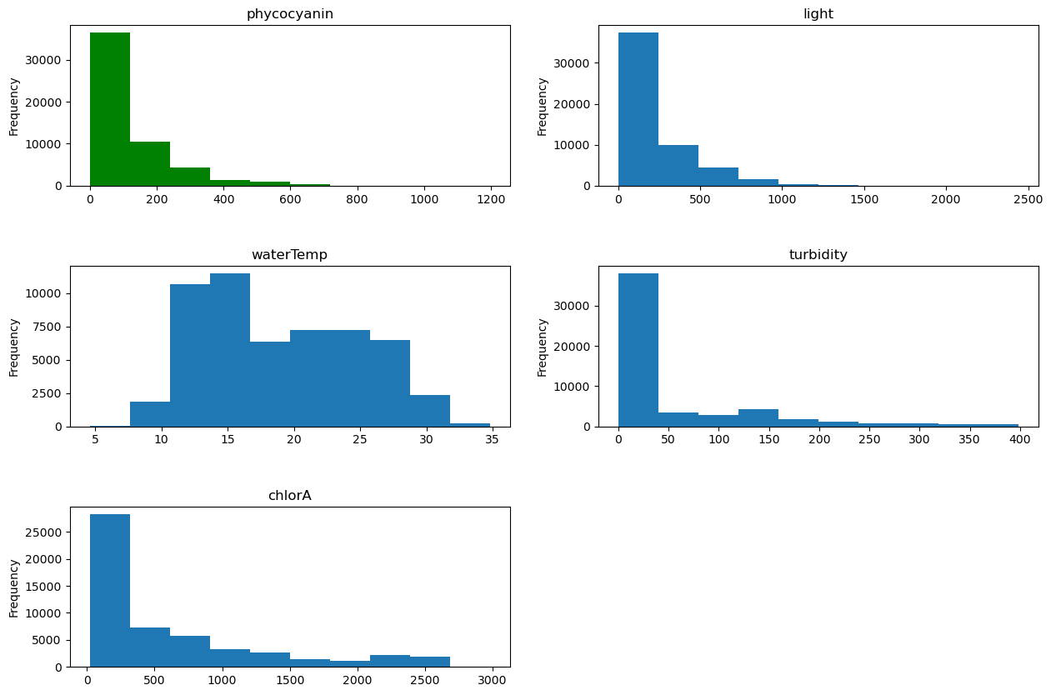
EDA: Distribution
Reflec boxplots
Not normally distributed
Right-skewed
Notes:
Lastly, I created histograms for each metric (Figure 4). These plots largely reflected the boxplots. No metric appeared to be normally distributed, however, water temperature was closer than the others. All other metrics were right-skewed.
Shapiro-Wilk test results for each metric had p values of 0.0 indicating not normal distributions. This agrees with the histograms.

Slide 10
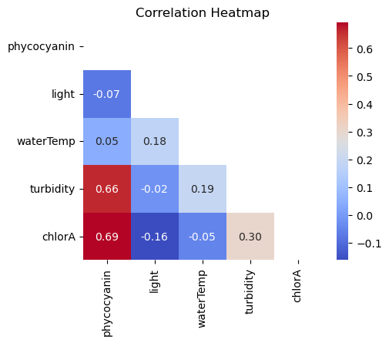
EDA: Correlations
Moderately strong correlations between phycocyanin and turbidity and between phycocyanin and chlorophyll-a.
Moderately weak correlations between turbidity and chlorophyll-a.
Metrics correlated with phycocyanin likely to be good predictors
Metrics with a low correlation to phycocyanin likely to be less relevant in the model
Notes:
I created a correlation heatmap between metrics to investigate linear relationships, specifically with phycocyanin (Figure 5). Heatmaps are an effective way to visualize many correlations at once, making it easy to identify correlations and patterns in correlations. The heatmap showed some correlations between the metrics. Moderately strong correlations occurred between phycocyanin and turbidity and between phycocyanin and chlorophyll-a. Moderately weak correlations occurred between turbidity and chlorophyll-a. The metrics correlated with phycocyanin are likely to be good predictors in the models. Conversely, the metrics with a low correlation to phycocyanin are likely to be less relevant in the model and could be excluded if needed during model development. No metric was very correlated (close to 1) with phycocyanin, which would have warranted removal from the data. I also created a pairplot (Figure 6) to further investigate linear relationships and also other relationships between phycocyanin and other metrics but no new observations were made.

Slide 11
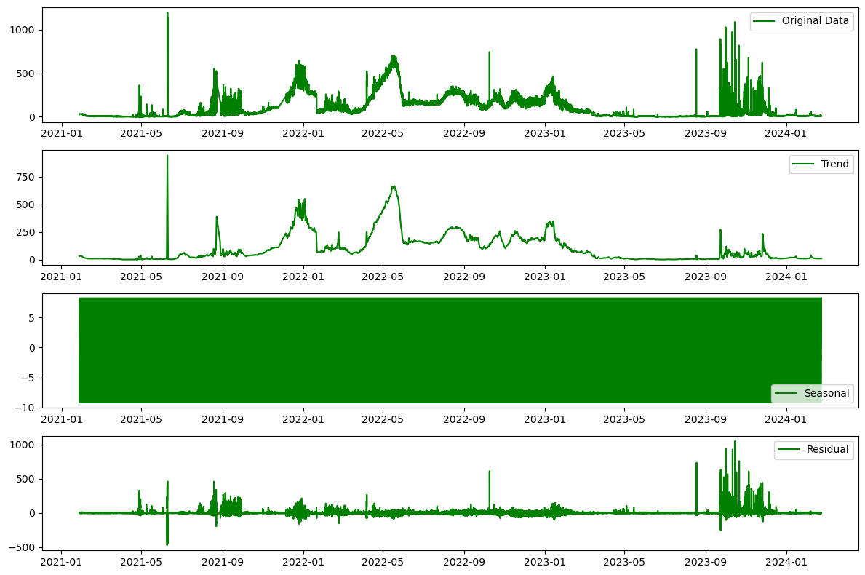
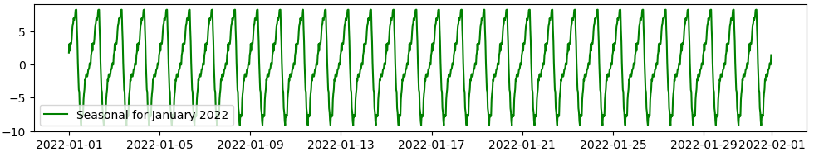
EDA: Stationarity
KPSS and ADF tests for each metric
Temperature, turbidity, and chlorophyll-a metrics are non-stationary
Phycocyanin and sunlight
KPSS test indicated non-stationary
ADF test indicated stationary
“Difference stationary”
All metrics need to be detrended
Notes:
I ran KPSS and ADF tests for each metric to test for stationarity.
Together, the KPSS and ADF tests indicated that the temperature, turbidity, and chlorophyll-a metrics are non-stationary. As for phycocyanin and sunlight, the KPSS test indicated that these metrics are non-stationary while the ADF test indicated that they are stationary. This apparent contradiction indicates that these three metrics are difference stationary. As a result, all metrics will need to be detrended through differencing techniques.

Slide 12
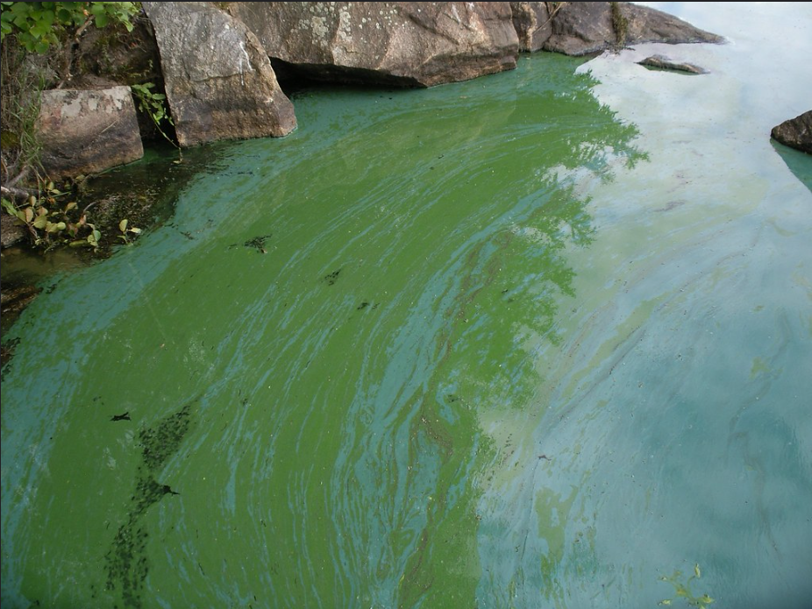
Engineering
One day mean of metrics so same as predictions
1,123 rows
Reran Shapiro-Wilks tests
Not normal distributions
Calculated natural logarithms
Reran Shapiro-Wilks tests
Normal distributions
Reran KPSS and ADF tests
Results similar to before
Detrenended with differencing to make stationary
Reran KPSS and ADF tests
All metrics stationary
Created 1 through 20 day lagged versions of the original features and the logged and differenced features
Notes:
Typically, time series data granularity, or unit, should be the same as the unit of the desired prediction, in this case, days. Therefore, I calculated the mean values of the metrics over a one day period so I could use these data for my models. This step can also sometimes normalize and/or make non-stationary data into stationary data. As a result of this process, the data frame was reduced to 1,123 rows.
I reran the Shapiro-Wilks test results for each metric. P-values were just above zero which was higher than previously but still far below 0.05 indicating not normal distributions. Many machine learning models require input data to be normalized.
The natural logarithm is often used for normalizing data, especially when the data has a heavily right-skewed distribution. Taking the natural logarithm can compress large values, making the distribution more symmetric and closer to a normal distribution. In addition, the natural logarithm is often used for detrending stationary data.
After performing natural logarithms, I reran the Shapiro-Wilk tests and all p-values were greater than 0.05 indicating normally distributed data.
I again ran the KPSS and ADF tests on the grouped and normalized data and found the results to be similar to before. The only difference was that both tests found the sunlight data to be stationary.
All metrics but sunlight required detrending so I performed differencing to compute the differences between consecutive data points. This technique is often performed for time series models and can transform a non-stationary time series into a stationary one and remove trends and seasonality. Overall, differencing can be beneficial because it stabilizes the mean and variance of the data, making it easier to identify underlying patterns and relationships.
I then ran the KPSS and ADF tests on the new features. The results indicated that all differenced features were stationary.
Creating lagged versions of data is also a common technique performed for time series models and incorporates temporal relationships involving past values into the model. I created 1 through 20 day lagged versions of the original features and the logged and differenced features. Lagging was done simply by copying and shifting the columns in the dataframe the appropriate number of days.

Slide 13
Pre-processing
Defined two different sets of X and y
Original data and lagged features of the original data
Transformed features and lagged features of the transformed data
Allowed comparison of the performance of the models using unaltered and transformed data
Notes:
I defined two different sets of X and y. One includes just the original and lagged features of the original data. The other, includes just the transformed features and lagged features of the transformed data. These two sets allowed me to compare the performance of the models using unaltered and transformed data. I chose to leave the the lagged phycocyanin features in X for the models because autocorrelation may be large part of forecasting phycocyanin

Slide 14
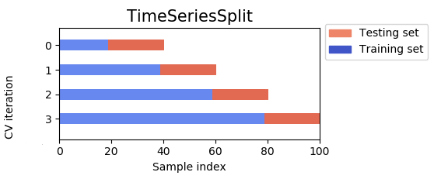
Modeling
Regression, random forest, XGBoost
Cross-validation using TimeSeriesSplit
Root mean squared error (RMSE)
Models were run multiple times starting with including non lagged feature data and adding a level of lagged feature data with each iteration up through the 20 lag features
Performed for both sets of X and y
RMSEs for each iteration were graphed and model with lowest RMSE was identified
Lowest RMSE from models using transformed data were un-transformed before comparison.
Notes:
Models capable of making predictions from time series data were essential for this project. I chose to explore linear regression, random forest, and XGBoost models.
For each model, rather than splitting, training, and testing once, cross-validation was performed to divide the data into 5 subsets and training and testing were performed five times using a different subset for testing each time. I specifically used TimeSeriesSplit() for my cross-validation because this function is specifically designed for time series data. Each fold is a superset of the previous one, ensuring that the model is trained on data that retains the temporal nature of time series data. Each fold was scored and averaged for a final score. This process avoids overfitting the model to the data and thus makes it more generalized for future data. The score I used was root mean squared error (RMSE) which measures the error between the model's predictions and the actual values.
Each model was run multiple times starting with including non lagged feature data and adding a level of lagged feature data with each iteration up through the 20 lag features. This process was performed for both sets of X and y. The RMSEs for each iteration were graphed and I was able to identify the number of lags for the model that would produce the lowest RMSE. The lowest RMSE from the models using the transformed data had to be un-transformed (un-natural logged and un-differenced) before comparing to the other RMSEs so that they were on the same scale. Once scaled correctly, I could then compare these best RMSEs between models.

Slide 15

Results
0.7-3.3% of the phycocyanin range (1654.64) which is considered low error.
Median (55) error would not constitute a blue green bloom at a dangerous level
Hypertuning for best RMSE of 12.4
 | Original Data |  | Transformed Data
Model | Lagged Features | RMSE | Lagged Features | RMSE
Linear Regression | 0-3 | 29.5 | 0 | 14.4
Random Forest | 0-13 | 43.7 | 0-8 | 12.8
XGBoost | 0-14 | 55.3 | 0-10 | 12.5
Notes:
First I ran the linear regression models using the original data and an increasing number of lagged days (Figure 8). The data indicates that using the original data and the data lagged 1-3 days produces the best linear regression model. A score of 29.5 is approximately 1.8% of the phycocyanin range (median was 55, mean was 166.73, min was 0.00, and max was 1654.64) which is considered low error. In other words, the error is not worrisome because the median of 55 +/- 29.5 RFU would not constitute a blue green bloom at a dangerous level.
Next I ran the linear regression model using the transformed data and an increasing number of lagged days (Figure 8). The data indicated that using the transformed data with no lagging produces the best linear regression model. After un-transforming the RMSE, I could compare it to other RMSEs. A score of 14.4 is approximately 0.9% of the phycocyanin range which is considered low error. In other words, the error is not worrisome because the median of 55 +/- 14.4 RFU would not constitute a blue green bloom at a dangerous level.
First I ran the random forest models using the original data and an increasing number of lagged days (Figure 9). The data indicated that using the original data and the data lagged 1-13 days produced the best random forest model. A score of 43.7 is approximately 2.6% of the phycocyanin range which is considered low error. In other words, the error is not worrisome because the median of 55 +/- 43.7 RFU would not constitute a blue green bloom at a dangerous level.
Next I ran the random forest models using the transformed data and an increasing number of lagged days (Figure 10). The data indicates that using the transformed data with 0 to 8 day lagged features produces the best random forest model. After un-transforming the RMSE, I could compare it to other RMSEs. A score of 12.8 is approximately 0.8% of the phycocyanin range which is considered low error. In other words, the error is not worrisome because the median of 55 +/- 12.8 RFU would not constitute a blue green bloom at a dangerous level.
First I ran the XGBoost models using the original data and an increasing number of lagged days (Figure 11). The data indicates that using the original data and the data lagged 1-14 days produces the best XGBoost model. Adding more lagged data improves the RMSE slightly but not enough to justify making the dataset more dimensional. A score of 55.3 is approximately 3.3% of the phycocyanin range which is considered low error. In other words, the error is not worrisome because the median of 55 +/- 55.3 RFU would not constitute a blue green bloom at a dangerous level.
Next I ran XGBoost models using the transformed data and an increasing number of lagged days (Figure 12). The data indicates that using the transformed data with 1-10 day lagged features produces the best XGBoost model. After un-transforming the RMSE, I could compare it to other RMSEs. A score of 12.5 is approximately 0.8% of the phycocyanin range which is considered low error. In other words, the error is not worrisome because the median of 55 +/- 12.5 RFU would not constitute a blue green bloom at a dangerous level. Overall, this model performed better than all other models.
I then performed hypertuning on this best model. I did this using a random search on many of the hyperparemeters for the XGBoost model. The model improved slightly to 12.4. This score is approximately 0.7% of the phycocyanin range which is considered low error. In other words, the error is not worrisome because the median of 55 +/- 12.4 RFU would not constitute a blue green bloom at a dangerous level.

Slide 16

Conclusion
XGBoost model using transformed data lagged at zero to 11 days produced the highest performing model to predict phycocyanin in Lake Fictitious
Error is small in the grand scheme of HABs where phycocyanin values are, at a minimum, in the several hundreds
Model could be very helpful for predicting blue-green algae in a lake before implementing a shutdown, allowing for planning and allocation of resources
Notes:
Overall, the tuned XGBoost model using transformed data lagged at zero to 11 days produced the highest performing model to predict phycocyanin in Lake Fictitious. While error in the prediction existed, it is small in the grand scheme of HABs where phycocyanin values are, at a minimum, in the several hundreds. A false positive of a lake operator closing a lake when phycocyanin is forecasted to be 200 RFU but, in fact, due to the error in the model, the real value is 187.6 RFU, is acceptable. Therefore, this model could be very helpful for predicting blue-green algae in a lake before implementing a shutdown, allowing for planning and allocation of resources.

